Slide 1
Web Searching and SVD
Group Members ​
​
Akshath Suresh R Rao - AM.EN.U4AIE20009​
Dhanush Krishna R - AM.EN.U4AIE20021​
Dhruv V S - AM.EN.U4AIE20022​
Durgapu Sathvik - AM.EN.U4AIE20024​
Pranav Jaysankar Nair - AM.EN.U4AIE20056
Presenter
Name: Pranav Jayasankar Nair
Roll No: AM.EN.U4AIE20056

Slide 2
The Problem
Every time when a person searches the internet for a particular topic, the search engine must yield relevant websites and will sort them using their relevance to the searched topic.
The search engine has to go through huge amounts of data and find the relevant information in the result.
The major difficulties are finding the relevant information among the huge clusters of data on the internet and the classification of the huge information in the web.

Slide 3
Methods Implemented
Web scraping
Tokenization
Stop word
Stemming
SVD
LSI

Slide 4

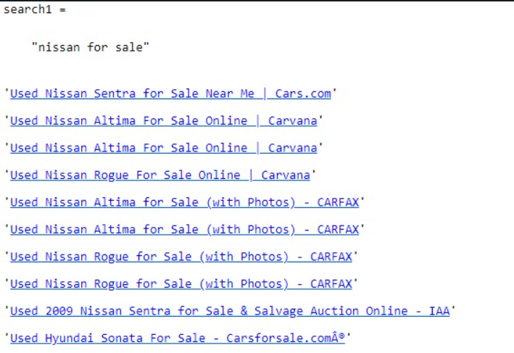
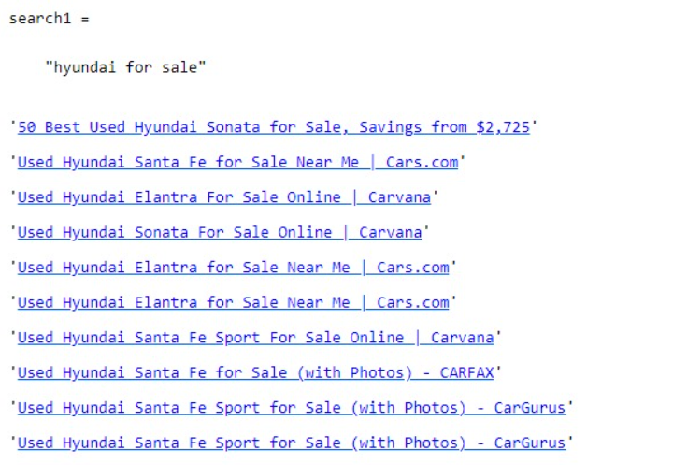
Results and Discussion

Slide 5
References
Nanda Zannibua Harisma and Anak Agung Putri Ratna, Implementation of automated essay grading system using LSA method with three keywords. Universitas Indonesia. Fakultas Teknik, 2008.
Heryanto, Ahmad and Christyowidiasmoro, Christyowidiasmoro and Hariadi, Mochamad. (2014). Search Engine Optimization Based On Latent Semantic Indexing Using Web Scraping.
Snasel, Vaclav and Abdulla, Hussam. (2009). Solution for Search Result Clustering by Using Singular Value Decomposition. 647 - 651. 10.1109/ICACTE.2008.143.
S. K. Malik and S. A. M. Rizvi, “Information Extraction Using Web Usage Mining, Web Scrapping and Semantic Annotation,” in 2011 International Conference on Computational Intelligence and Communication Networks (CICN), 2011, pp. 465–469.
Scott Deerwester, Richard Harshman, Susan T, George W, and Thomas K, “Indexing by Latent Semantic Analysis,” J. Am. Soc. Inf. Sci., vol. 41, no. 6, pp. 391–407, 1990.

